Slide 1
Employee/Staff Cybersecurity Awareness Training Employee Cybersecurity Made Simple with P V R

Slide 2
Our goal
Achieve better cybersecurity results by
making concepts simple and
providing simple action steps

Slide 3
Cybersecurity Awareness Made Simple
What is it?
Cybersecurity = Protection
What are you Protecting?
Data and Systems
How are you Protecting it?
Internal Controls

Slide 4
What is “Cybersecurity”?
Cybersecurity is a set of Internal Controls to protect data and systems from fraud, waste, and abuse.
Fraud, waste, and abuse can come in many forms:
Theft of data
Theft of funds such as misdirected payroll or vendor payments
Unauthorized access to systems or other assets
Network or system disruption or damage from attacks
Costs and damages to make repairs from an incident

Slide 5
Why Does this Matter to Me?
Government cyber crime has exploded
Cyber criminals are highly organized (conglomerates) and seek to shut down systems, steal data and funds
Government data and systems are “high value assets” and therefore prime targets
Criminals targeting YOU to TRICK you into helping them steal data and money, or lock down your networks

Slide 6
Two Major Cybersecurity Risks for You at Work
Being tricked into clicking on malicious links/prompts/infected attachments/audio files, or giving your credentials (login) Ransomware can lock up files and systems
Being tricked into processing a transaction based upon a fraudulent request (“phishing” and “social engineering”) Loss of funds for Department and payees

Slide 7
But, I am not a cybersecurity expert!
In reality, most staff are not cyber experts.
Cybersecurity is NOT just an IT issue.
Everyone at every level has a role in protecting your Department
What it means to you: simple internal controls to protect yourself (at work and at home) and your department

Slide 8
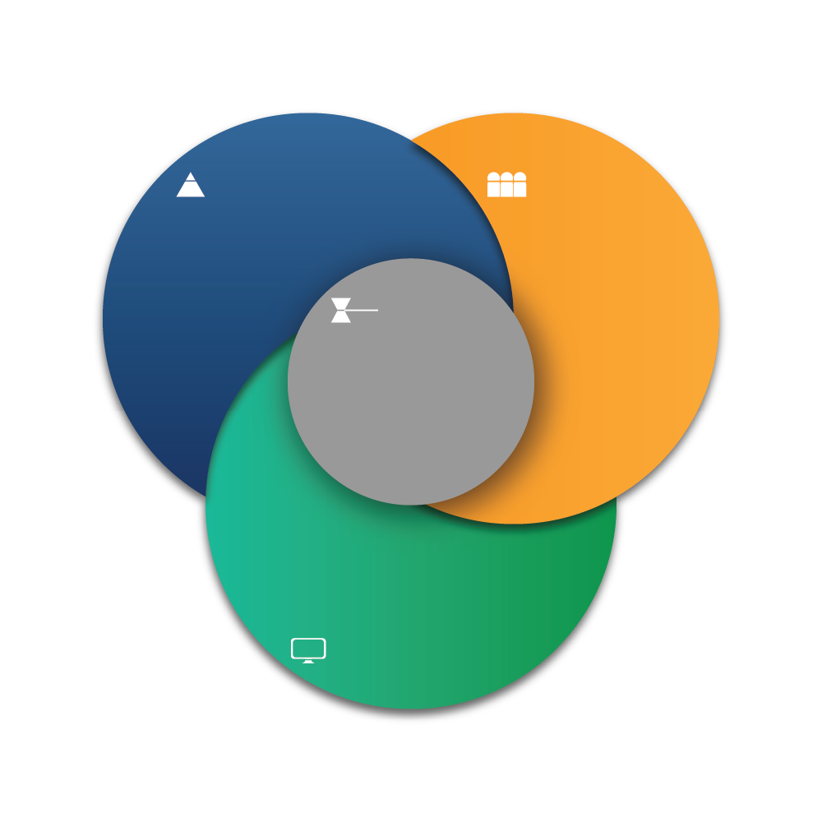
Leadership
Employees
Department Head sets:
Governance model
Tone from the Top
Perform Daily Operations following
Governance model
Governance
Internal Control Plan/System
Mission, Goals, Directives
Operational Procedures
Data Management
Equipment, networks, and systems to support daily operations
Technology & Systems

Slide 9
What is Governance? (Internal Controls)
Every Department action has
legal/fiscal compliance rules
budgetary costs
Internal Control Plan/System
Mission, Goals, Directives
Operational Procedures
Data Management
Governance
Internal Control Plan/System
Mission, Goals, Directives
Operational Procedures
Data Management

Slide 10
Governance (Mission, Internal Controls, Operations)
Internal Control Plan – System of Internal Controls
Official documentation by Leadership of the Department mission, goals, risks, controls and operations
Compliance requirements includes data and system management (Ex. EOTSS Information Security Standards, Privacy Laws)
Why does this matter? Internal Controls are the basis for audits
First place auditors look is Internal Control Plan
Audits require proof that expenditures and operations meet compliance rules, mission and funding authorization
Notes:
No matter what role you have in your department you will have internal controls that apply to your position
When you are hired, you are required to review and sign a variety of policies (such as non-discrimination, workplace violence, ethics requirements)
Related to equipment, you are required to sign for any office assigned equipment that you use both in the office and virtually as well as an “Acceptable Use Policy” which are the guidelines for using department resources.

Slide 11
Example of Internal Controls Commonwealth Default Information Security Standards
Enterprise Information Security Policies and Standards align with industry best practices, National Institute of Standards and Technology framework and Center for Internet Security
Mandatory for Executive Departments
Mandatory for Non-Executive Departments unless they adopt stricter standards
Your department includes these standards in the Internal Controls
You will be provided with operational steps to meet these controls (ex. Multi-Factor Authentication, long passwords, VPN, security roles)

Slide 12
Leadership Role
Leadership
Governance
Internal Control Plan/System
Mission, Goals and Directives
Operational Procedures
Data Management
Department Head sets:
Governance model
Tone from the Top
Operations performed within
Budget and Governance model

Slide 13
Leadership Role
Leadership is charged with
Aligning the department mission, goals and operations with required compliance rules and available funding
Establishing a Governance model with operational controls to achieve mission and prevent fraud waste and abuse of public resources
Assigning appropriate staff at all levels of the organization to ensure compliance with internal controls.
“Tone from the Top” – Leadership directive that employees perform operations in accordance with the Internal Control Plan/System.

Slide 14
Technology and Systems Role
Governance
Internal Control Plan/System
Mission, Goals and Directives
Operational Procedures
Data Management
Manage equipment, networks, systems and security to support daily operations
Technology and Systems

Slide 15
Technology and Systems Role
Provide guidance on use of equipment, networks, and security
Provide access to networks and systems based upon your specific role and responsibilities
System access may be limited to ensure “segregation of duties” (limits broad access to prevent risks of fraud)
System access and roles are audited for appropriateness and segregation of duties
Required security controls may require additional steps or sign-on to protects systems (this may seem burdensome but supports security)

Slide 16
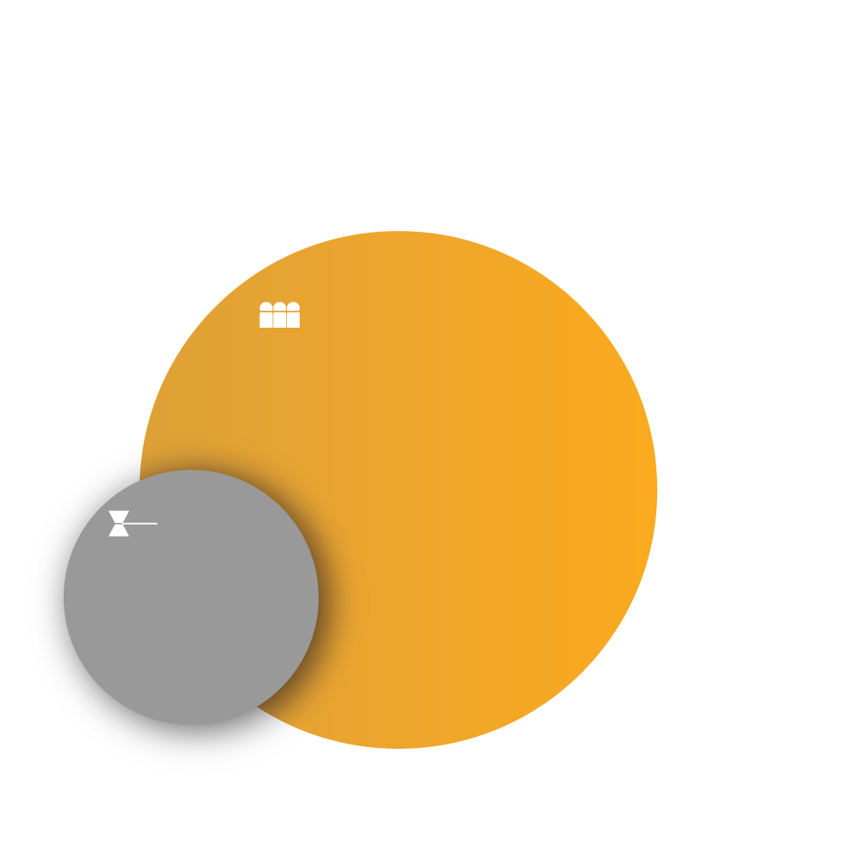
Employee Role
As an Employee:
Follow assigned Internal Controls
Protect yourself, Data and Systems
Employees
Perform Daily Operations following Governance model that applies to their roles and duties
Governance
Internal Control Plan/System
Mission, Goals and Directives
Operational Procedures
Data Management
Notes:
Kassie: what does cybersecurity have to do with me?
Rachel: Believe it or not Kassie cybersecurity has a lot to do with you. Especially as an employee.
Kassie: I do not know anything about cybersecurity, and the position I hold has nothing to do with cybersecurity. Doesn’t the IT department deal with this?
Rachel: Regardless of the position that you hold. Cybersecurity is crucial for you and every employee.
Kassie: Why is it crucial? Isn’t this the IT department’s role?
Rachel: As an employee, you are required to follow your Internal Control Plan and internal procedures to protect your Department’s DATA and SYSTEMS from fraud, waste, and abuse. Cybersecurity is just the set of internal controls to protect the data and systems that you use daily to perform your operational tasks.
Kassie: So, how do I become more aware of my risks?
Rachel: To become cyber aware! Cyber awareness is designed to remind you of how you can protect data and systems from cybercrimes
\

Slide 17
Acceptable Use of Information Assets (EOTSS Standards IS.002.6.2)
Personnel are encouraged to
Act in a professional and ethical manner
Comply with
Department’s applicable Code of Conduct
Relevant enterprise and agency-level policies

Slide 18
Unacceptable Uses of Information Technology Resources
Illegal acts, violations of state or federal criminal or civil laws or regulations
Political or any commercial purpose
Threatening or harassing messages, whether sexual or otherwise
Access or sharing sexually explicit, obscene or otherwise inappropriate materials
Infringing on intellectual property rights
Attempts to gain unauthorized access to any computer or network (hacking)
Interference/disruption of network resources, including viruses/ransomware
Intercepting communications intended for other persons
Misrepresenting an agency or a person’s role at the agency
Distributing chain letters
Accessing gambling sites
Libel or defaming any person

Slide 19
Examples of Internal Controls to prevent personnel from engaging in harmful email practices
Do not use email accounts for commercial purposes unrelated to Commonwealth business.
Do not conduct government business through or send confidential information to or from a personal email account.
Do not send confidential information to any recipient not authorized to receive (UAIDS, Social Security Numbers, date of birth, health information)
Do not use email to transmit confidential information in an unencrypted (unprotected) format.
Do not collect and/or transmit material in violation of any federal, state, or local law or organizational policy.

Slide 20
If You TOUCH it…
You’re Touching Data and Systems!
Don’t be a Cyber Victim!
Don’t let the Bad Guys in!
Notes:
Your agency can have a data breach if you click on one simple link that a hacker sent out.
as soon as you touch a mouse, keyboard, desktop, or laptop you are touching the data. With just one wrong and careless click you could put your agency at serious risk! If you are touching it, you are responsible for protecting it

Slide 21
Data you may touch
Employee Payroll/HR Data Personal Information
HR/CMS
Other applications
Department Data
Student Records
FERPA
Health Care Data
HIPAA
Other Personal
Sensitive
Confidential Data
Financial Data: Bank accounts, Credit Card Numbers, Electronic Funds Transfer, Direct Deposit, MMARS, other applications
Any data you touch has legal and compliance rules.
If it is personally indentifiable information or confidential you MUST PROTECT the data and systems from cyber fraud.
Department Operations

Slide 22
Privacy Laws Mandate Protection of Confidential Data
If you touch or have access to confidential data as part of your role you are responsible for protection of that data
Remove (not just hide) confidential data prior to sharing/posting
Confidential data must be securely exchanged only through authorized methods (make sure you verify process)
DO NOT email confidential information or post in unencrypted (not password protected) folders or in unprotected format.
ex. Don’t share in Teams or Sharepoint unless password protected and don’t give to anyone unless they have authorization to access that confidential data.
If you are unsure – ASK!

Slide 23
How Do I Protect Myself, Data and Systems?
Cybersecurity is not as complicated as you may think
You are already using cyber controls
Passwords (12-16+ characters and no repeats across apps!)
Multi-Factor Authentication (MFA) -- Always set it up
VPN (Virtual Private Network – Pulse)
Don’t be afraid – We’ve got you!
CTR has re-branded basic employee cybersecurity into 3 simple cction steps!

Slide 24
Cybersecurity is simple when you P V R

Slide 25
PAUSE before clicking on anything
Am I expecting this email or call?
Do I recognize the sender?
Is it from inside my organization? (mass.gov, .edu, or official email)
Be cautious if outside your organization
Is there a sense of urgency?
Does it have an attachment, logo, QR code, audio file?

Slide 26
PAUSE and look out for anything odd
Urgent emails or texts that demand immediate response
Any email or text that states your access or password has expired
Any email or text asking you to click on a link, logo or box to access a file (such as SharePoint, Office 365)
Any email or text that warns that “your account will be closed” or “there was an unauthorized login attempt”
Grammatical errors and/or misspellings
A generic greeting instead of your name
Sent outside of normal working hours
Sender's name/email/phone does not match company
Notes:
What if I am pausing and I don’t notice anything wrong, does that mean the email is safe?

Slide 27
Watch out for phishing texts
Goal is to scare you into following link to verify charge.
DO NOT EVER CLICK ON THESE LINKS
Bank/credit card/PayPal/Venmo etc. will appear on your “official” account
Log in to your official account to verify activity
If there is any irregularity or concern, change your password (16+ characters and no repeated passwords)
DO NOT CALL PHONE NUMBER PROVIDED (Use official help desk number)

Slide 28
Suspect Links (notice misspellings) Don’t Click!
Top Level Domain
Primary Domain
Sub Domain / Server Name
Numbers hide ownership
Spelling errors

Slide 29
Don’t Fall For Pings to Respond
“Prompt Bombing” is a series of texts or pop ups ask you to accept or deny credentials or approve through your Authenticator app
Usually repeated texts at off-work hours, such as midnight when it is most annoying
Texts appear to be from IT staff, Microsoft, Apple, Authenticator, or any provider that you may be using
Texts state that you will continue to be prompted for a response, or click “yes” to stop.
DON’T get worn down and end up selecting one of the buttons to make it stop, as this grants access to the office network
EXIT out of text or authenticator without clicking and contact IT support. If for home cell, close out and contact provider through help desk.

Slide 30
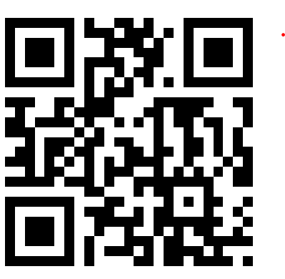
What NOT to Click
Links
Logos
QR Codes
Audio files
Criminals use colors and graphics to encourage clicking
Even if the name is familiar
DO NOT FALL FOR IT

Slide 31
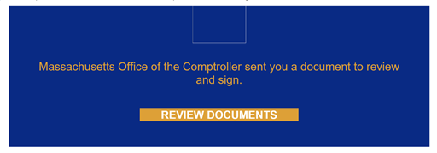
Electronic signatures
DocuSign, Adobe Acrobat Sign
These may look official but always PAUSE and VERIFY with the sender that these are legitimate.

Slide 32
Verify, Verify, Verify
Do not click until you verify (Zero Trust)
Do NOT rely solely on electronic paperwork, calls or texts
Follow written validation, processing procedures and checklists
Always VERIFY major changes PERSONALLY with the requester
Payroll or Banking account (EFT/Direct Deposit employees/vendors (VCM)
Contract document changes
Any department business requested electronically
Office 365 requests to “collaborate” or join groups (even if internal)
ASSUME EVERY EMAIL OR TEXT MAY BE MALICIOUS

Slide 33
How do I “Personally” Verify?
Contacting the sender through an alternate channel “Did you send me this attachment, collaboration link, request?”
Ex. DocuSign/Adobe Sign requests for signature; Office365 or SharePoint request to join a collaboration, or view a document
For transactions (employee/vendor), in person, Zoom, or FaceTime (not just phone call – can be spoofed)
If you don’t know the employee/vendor, asking them to show official ID (screenshot)
Setting up validation PIN or keyword for Vendor Authorized signatories
Making no contract changes unless authorized signatory validated

Slide 34
Report concerns immediately
If you cannot verify request/requester is legitimate
Trust your gut – if request seems odd - Report
Report to your supervisor/assigned contact
Use the “Phish” report button if set up for your email
Follow your assigned internal protocols
DO NOT BE AFRAID TO REPORT!

Slide 35
Teleworking and Hybrid Tips Reminders
Use Office approved equipment with appropriate VPN and virus protections (not personal devices)
Do NOT “plug in” your work devices to free USB ports in public areas or use free cables (often infected!)
Never provide personally identifiable information, business credentials, login or account information to get access to ‘free’ Wi‐Fi’
Use “long” and “strong” passwords (12+ characters no repeats!)
DO NOT use similar passwords as social media accounts
Use Multi-Factor Authentication – Always set it up
Make sure operating systems, browser, virus and malware protections are up-to-date according to your department security requirements

Slide 36
Teleworking and Hybrid Tips Reminders
Secured Wi-Fi - At home Follow your internet provider instructions to change the password on your router to a Long and Strong password (12+ characters and no repeats!)
Yes it will require updating all smart devices, apps, games)
If your internet provider/router allows multiple networks (main and guest) set up multiple networks with different names and passwords for work, family/smart devices and guests
Try not to use smart devices on the same network as your work network (Alexa, Google Assist, Nest, Wink, Ring, etc.)
NEVER allow others (kids, family, friends) to surf web, stream movies, play games on office-assigned devices (it only takes pme click!)

Slide 37
Use PVR at Home too!
Use Pause, Verify, Report to keep your family data and equipment safe
Remind your kids, elders, and friends to pause before clicking
Always make sure the email, text or call requester and request is valid
To service providers when you find spam, delete suspicious emails and texts

Slide 38
Cybersecurity is simple when you PVR
Notes:
Rachel: Now we will give you an overview of PVR

Slide 39
Always contact your supervisor or manager for IT Support
Be Cyber Safe and PVR!

