Slide 1
Pause, Verify, Report Employee Micro Training - Cybersecurity Made Simple with P V R

Slide 2
Our goal
Achieve better cybersecurity results by
making concepts simple and
providing simple action steps

Slide 3
Two Major Cybersecurity Risks for You at Work
Being tricked into clicking on malicious links/prompts/ infected attachments/audio files, or giving your credentials (login) Ransomware can lock up files and systems
Being tricked into processing a transaction based upon a fraudulent request (“phishing” and “social engineering”) Loss of funds for Department and payees

Slide 4
How Do I Protect Myself?
Cybersecurity is not as complicated as you may think
You are already using cyber controls
Passwords (12-16+ characters and no repeats across apps!)
Multi-factor Authentication (Always set it up)
VPN (Virtual Private Network – Pulse)
Don’t be afraid – we’ve got you!
CTR has re-branded basic employee cybersecurity into three simple action steps!

Slide 5
Cybersecurity is simple when you PVR

Slide 6
PAUSE before clicking on anything
Am I expecting this email or call?
Do I recognize the sender?
Is it from inside my organization? (mass.gov, .edu, or official email)
Be cautious if outside your organization
Is there a sense of urgency?
Does it have an attachment, logo, QR code, audio file?

Slide 7
PAUSE and look out for anything odd
Urgent emails or texts that demand immediate response
Any email or text that states your access or password has expired
Any email or text asking you to click on a link, logo or box to access a file (such as SharePoint, Office 365)
Any email or text that warns that “your account will be closed” or “there was an unauthorized login attempt”
Grammatical errors and/or misspellings
A generic greeting instead of your name
Sent outside of normal working hours
Sender's name/email/phone does not match company
Notes:
What if I am pausing and I don’t notice anything wrong, does that mean the email is safe?

Slide 8
Watch out for phishing texts
Goal is to scare you into following link to verify charge.
DO NOT EVER CLICK ON THESE LINKS
Bank/credit card/PayPal/Venmo etc. will appear on your “official” account
Log in to your official account to verify activity
If there is any irregularity or concern, change your password (16+ characters and no repeated passwords)
DO NOT CALL PHONE NUMBER PROVIDED (Use official help desk number)

Slide 9
Don’t Fall For Pings to Respond
“Prompt Bombing” is a series of texts or pop ups ask you to accept or deny credentials or approve through your Authenticator app
Usually repeated texts at off-work hours, such as midnight when it is most annoying
Texts appear to be from IT staff, Microsoft, Apple, Authenticator, or any provider that you may be using
Texts state that you will continue to be prompted for a response, or click “yes” to stop.
DON’T get worn down and end up selecting one of the buttons to make it stop, as this grants access to the office network
EXIT out of text or authenticator without clicking and contact IT support. If for home cell, close out and contact provider through help desk.

Slide 10
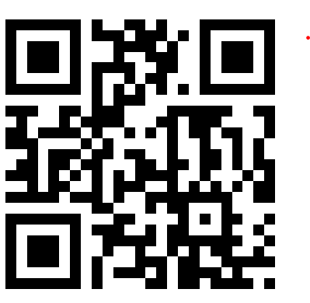
What NOT to Click
Links
Logos
QR Codes
Audio files
Criminals use colors and graphics to encourage clicking
Even if the name is familiar
DO NOT FALL FOR IT

Slide 11
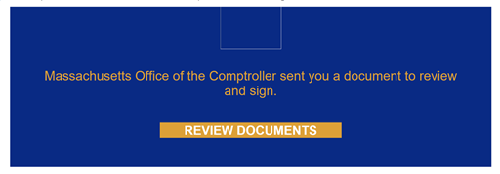
Electronic signatures
DocuSign, Adobe Acrobat Sign
These may look official but always PAUSE and VERIFY with the sender that these are legitimate.

Slide 12
Verify, Verify, Verify
Do not click until you verify (Zero Trust)
Do NOT rely solely on electronic paperwork, calls or texts
Follow written validation, processing procedures and checklists
Always VERIFY major changes PERSONALLY with the requester
Payroll or Banking account (EFT/Direct Deposit employees/vendors (VCM)
Contract document changes
Any department business requested electronically
Office 365 requests to “collaborate” or join groups (even if internal)
ASSUME EVERY EMAIL OR TEXT MAY BE MALICIOUS

Slide 13
How do I “Personally” Verify?
Contacting the sender through an alternate channel “Did you send me this attachment, collaboration link, request?”
Ex. DocuSign/Adobe Sign requests for signature; Office365 or SharePoint request to join a collaboration, or view a document
For transactions (employee/vendor), in person, Zoom, or FaceTime (not just phone call – can be spoofed)
If you don’t know the employee/vendor, asking them to show official ID (screenshot)
Setting up validation PIN or keyword for Vendor Authorized signatories
Making no contract changes unless authorized signatory validated

Slide 14
Report concerns immediately
If you cannot verify request/requester is legitimate
Trust your gut – if request seems odd - Report
Report to your supervisor/assigned contact
Use the “Phish” report button if set up for your email
Follow your assigned internal protocols
DO NOT BE AFRAID TO REPORT!

Slide 15
Use PVR at Home too!
Use Pause, Verify, Report to keep your family data and equipment safe
Remind your kids, elders, and friends to pause before clicking
Always make sure the email, text or call requester and request is valid
To service providers when you find spam, delete suspicious emails and texts

Slide 16
Cybersecurity is simple when you PVR
Notes:
Rachel: Now we will give you an overview of PVR

Slide 17
Always contact your supervisor or manager for IT Support
Be Cyber Safe and PVR!

